Slide 1

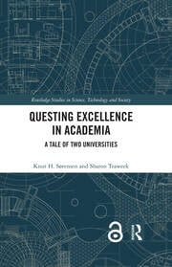
The university as a place and a context for research: Academic freedom, canons, epistemic authority, and epistemic politics
Knut H. Sørensen
2025-05-13

Slide 2
Today, I invite you to consider how working at a university may influence your research
Any initial thoughts?
Is it different from doing research in the institute sector, e.g., Sintef, or in industry? How?
Advantages? Disadvantages?

Slide 3
Intro: a changing mood
Up till now, Norwegian universities have been characterized by careful optimism
But, a 2024 survey of employees in higher education found that:
  Two out of three say they are already affected by cuts at their institutions.
  More than 90 % are worried that cuts will affect their work situation negatively in the future.
  Two out of three fear for their own employment, and nearly every respondent is somewhat or very concerned about the professional development, the research, the teaching and the work environment.
  PhDs and postdoctoral researchers are the most concerned.

Slide 4
2025 – a new year of university drama
  US universities under attack. Academic freedom is bluntly violated – Trump and Vance
  Gaza and worldwide student protests
  Widespread uneasiness about the role of higher education
  Academic careers appear less attractive due to precarity and workloads

Slide 5
Nevertheless, universities are important, which have some consequences
“From modest beginnings over nine hundred years ago, it [the university] has become the quiet but decisive catalyst in modern society, the factor essential to its effective functioning and well-being” (Frank Rhodes, 2001: xi).
What does this mean in practice?
  External and internal pressure to contribute to social development. Great expectations!
  Disciplining measures like performance metrics and reporting
  In Norway, increasing political emphasis on deadlines and completion of degrees

Slide 6
Definition of a university
An institution of higher learning providing facilities for teaching and research and authorized to grant academic degrees (Merriam-Webster)
Notice the implicit emphasis on the unity of research and teaching – a defining quality of universities
To discuss: How may the idea of a unity of research and teaching impact your research?

Slide 7
This lecture addresses universities as socio-epistemic environments of research and scholarship
Standard theories of science have a cognitive bias, a disembodied or internalist view of science, with focus mainly on issues such as
  Methodology
  Objectivity
  Demarcation criteria
  Rationality (or lack of)
  The structuring and logic of arguments
Today, we engage in “homework”, reflecting on features of everyday life at universities and what that means for our conditions for doing research

Slide 8
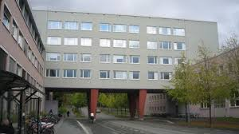
Some basic socio-epistemic features of universities
Research is done in the same place as teaching and supervision. Faculty are (mostly) both teachers and researchers. Teaching is a vital link between research and society!
Universities are intersected by comprehensive national and transnational networks/meshworks related to research but also to teaching and outreach. This makes universities into critical nodes in society’s knowledge ecologies.
Offers a comprehensive infrastructure, including libraries and digital networks
The architecture provides spaces for work and interaction but also a physical environment for thinking

Slide 9
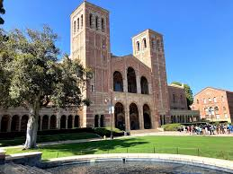
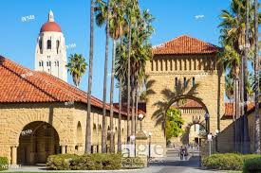
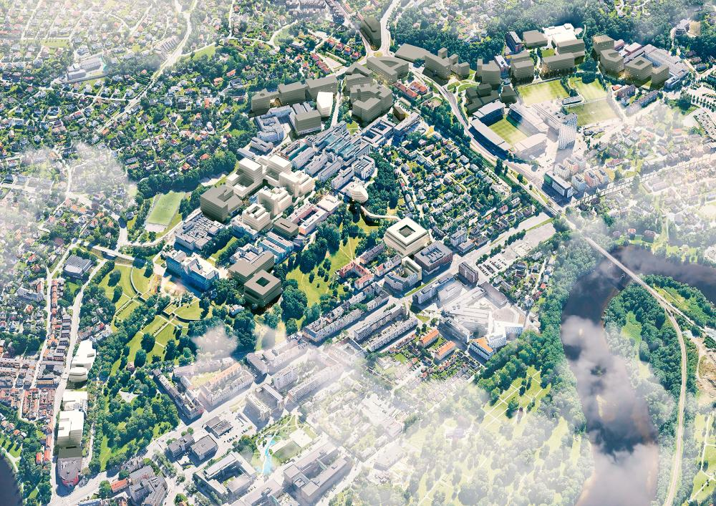
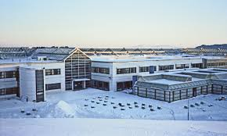
Universities as physical places of research – where would you prefer to be?

Slide 10
Universities as an object of policy attention. In Norway, a deluge of reforms after 2000
Accounting reform
Audit reform
Bologna reform
Throughput reform
PhD expansion reform
Excellence pressure
Structure reform – mergers & closings
Educational quality reform
Appointments structure reform
Gender balance reform
Publication reform – Plan S
Industry contact reform
Innovation and commercialisation
Internationalisation
Digitalisation
Open science
Bureaucracy cut reform
Ongoing: working life adaptations of teaching
Competence reform
Funding reform
Regionalisation of higher education
Language reform

Slide 11
How do you experience this situation?
Or don’t you think much about it?

Slide 12

The reform deluge shape our conditions of doing research – our epistemic living spaces
Epistemic living spaces are “researchers’ individual or collective perceptions and narrative re-constructions of the structures, contexts, rationales, actors and values which mold, guide and delimit their potential actions, both in what they aim to know as well as in how they act in social contexts in science and beyond.” (Ulrike Felt)

Slide 13
External vs. internal forces
Clearly, policies, funding regimes, and bureaucratic rules circumscribe our research practices significantly.
To the extent that academics complain about their epistemic living space, external factors get the most attention.
I argue that from a theories of science perspective, the practice of academic freedom and internal activities like the exercise of canons, epistemic authority and epistemic politics also shape our scholarly agency substantially.
Thus, we also must look inwards, not only outwards, to see how our socio-epistemic space for research is shaped. Let us start with academic freedom and its consequences.

Slide 14
What is academic freedom?
In principle, university scholars have the freedom to choose research topics, research questions, theoretical approaches, methods, and publication format as well as the content of their teaching.
Academic freedom is legally granted in Norway (and in many other countries), but in fairly general terms and with an institutional rather than individual emphasis.
Academic freedom means that self management should prevail in the everyday work of academics. Is this how things are?

Slide 15
Academic freedom is policed internally
“Academic freedom may be defined as the freedom to conduct research, teach, speak and publish, subject to the norms and standards of scholarly inquiry, without interference of penalty, wherever the search for truth and understanding may lead” (Colloquium of University Presidents, USA).
Thus, academic freedom of individuals is situated in the culture of disciplines and departments, in other words in local and translocal epistemic politics, the struggles who hold relevant expertise
What are the implications?

Slide 16
Some ambiguities of academic freedom shape the socio-epistemic space for research
The principle of academic freedom offers some but not absolute protection for individuals and communities from external influences, like politicians.
At the same time, academic freedom invites communities such as disciplines, departments, research groups, etc.,, to do internal disciplining through the establishment of canons and epistemic authority and the conduct of epistemic politics, including peer review, but also seminar discussions
Notes:
.

Slide 17
The relative autonomy of research – a girder of our socio-epistemic space
Academic freedom is based on an informal contract with society. Academics shall provide public goods in return for their freedom of research and teaching. Meritocracy is assumed to be the entrance system.
Some concerns:
  The importance of external research funding means that relevance concerns often shape problem choice
  Does the intense competition for resources and positions affect academic freedom?
    The Norwegian promotion system

Slide 18
How do you experience academic freedom?
To what extent do you think you have academic freedom?
What limits your academic freedom?

Slide 19
Some internal issues that may affect individual academic freedom
Canons
Epistemic authority
The conduct of epistemic politics
Meritocracy
Assessment games

Slide 20
Internal issue I: canons
Most scientific and scholarly communities have canons – knowledge, methods, texts that are selected to define the community
Clearly, canons facilitate communication but impose on individual academic freedom by restricting the socio-epistemic space. What are the correct/appropriate statements?
Should we do away with canons?

Slide 21
Internal issue II: epistemic authority
Epistemic authority results from being recognised as an expert on a particular topic, as one who knows. In a professional setting, this may involve power games and harassment. Who dares to challenge epistemic authority?
Epistemic authority may be exercised to define standards to assess the quality of research, but also to marginalise positions.
Thus, the exercise of epistemic authority produces hierarchy, inclusion/exclusion, and power, possibly epistemic injustice.

Slide 22
Internal issue III: The conduct of epistemic politics
Epistemic politics is the local practice of arguing about what constitutes high-quality research, proper academic writing, proper academic expertise, the range of that expertise, and who may be considered good enough or the best experts
Intimately linked with meritocracy and how academic freedom is practiced in a scientific or scholarly community
Plays out in collegial settings such as faculty meetings, seminars, and ‘corridor talk’
It may result in harassment and other forms of improper mobilization of epistemic authority.

Slide 23
IV. Meritocracy: the belief in fair assessment
Meritocracy is a dominant academic assumption – merit is the only thing that should count in assessments for positions and promotions.
Success in getting positions and promotion – a matter of excellence, suitability, or luck? Complicated because ‘merit’ is not well defined
We recognize that assessments may be unfair, but we continually prepare to be assessed.
Thus, academics have a ‘double bind’ (Gregory Bateson) relationship to meritocracy: hope and belief in justice vs. disbelief and bad experience
This causes epistemic uncertainty. Self-doubts are not helpful to research

Slide 24
V. Assessment games. The metrification of research
Metrification of research is the increased use of quantitative indicators of productivity and quality that results in:
  Publication pressure
  Pressure to publish in so-called high-ranking journals
  Pressure to obtain external funding
Metrification is intimately linked to merit and meritocracy as a temptation to count rather than read
Institutional versus individual assessments

Slide 25
Conclusion I: The socio-epistemic circumstances of university research
External forces imposing
  Funding opportunities and the need for navigating “relevance”
  Disciplining for providing public goods
  Ideological pressure
  Bureaucratic rules and assessment through metrics
Internal circumstances
  Opportunities related to the research-teaching nexus and universities’ extensive knowledge ecologies.
  Epistemic disciplining through canons, epistemic authority, and assessment practices
  Hierarchy
  Time-consuming and potentially uncomfortable epistemic politics.

Slide 26
Conclusion II: Are Norwegian universities in trouble?
Should I stay or should I go?

