Slide 1
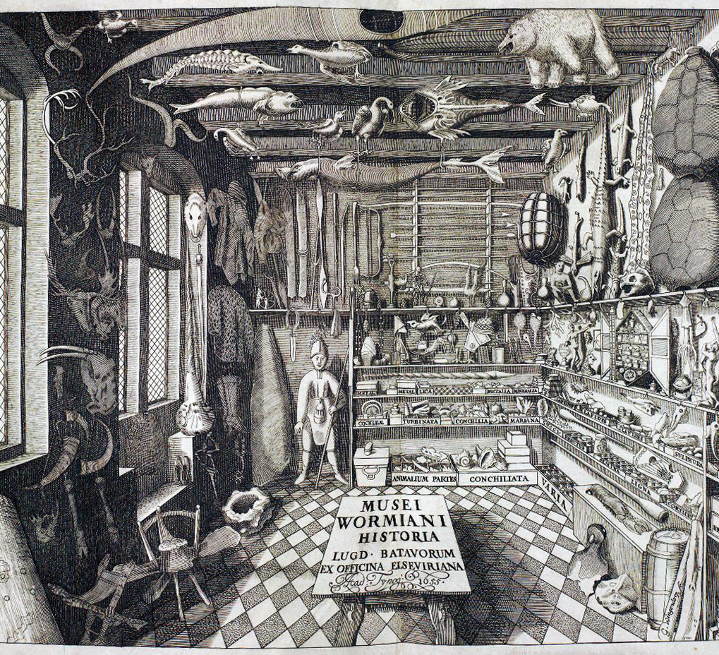
History of science and changes in the scientific life
Terje Finstad

Slide 2
Today
915-10: The history of science, what, how and why?
1015-11: The scientific life, some versions
1115-12: Discussion

Slide 3
The history of science
What, how and why?

Slide 4
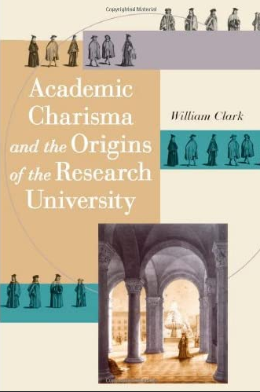
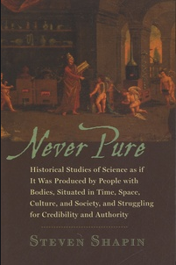
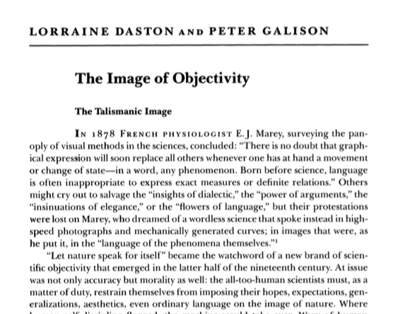
Readings

Slide 5
Science, a difficult category
Internalist perspectives: science is based on a particular cognitive rationality that can be found in its methods.
  - If the foundation is good (rational thinking) and the methods used are good and used right, then we get facts/true results
Externalist perspectives: Little, if anything, separates science from other practices (= different kinds of relativism/postmodernism) ulike typer relativisme/ postmodernisme)
  - Science is a product of cultural and societal aspects of it own time → Scientific knowledge is only an expression of power relations; gender, class, ethnicity, values and interests etc.
Both understandings are problematic in that they don’t really care about the production of science, about practice
Focus on people, perspectives, money, equipment, resources and/or what is produced (facts, truth)
Also, can there really be a history of science? Science, vitenskap, wissenschaft etc.

Slide 6
Science according to STS
Critical to the humanities and social sciences for not studying the production of knowledge
Using historical and social scientific methods, they wanted to empirically investigate what scientists do when they do research. Research as a concrete practice
Followed Kuhn in his claim that both methods/cognitive and social/cultural mechanisms are at work in scientific communities and research, and stated that both should be studied simultaneously
Wanted to get passed both cognitive and social apriori claims by investigating them empirically
As other phenomena, science is something that is made, used and works in the world

Slide 7
Shapins history of science
The role of science and scientists, what they do when they produce knowledge, why they do it, how scientific practice is linked to both internal and external forces, needs, beliefs and interests
Science is never pure – neither researchers or scientific practice should be separated from the contexts they are part of
Cultural history of science

Slide 8
8 points for ‘lowering the tone’
Focus on context and to study the past on its own terms
Move away from handing out ‘medals for modernity’ to scientific heroes
Science can be studied just like other practices and institutions in society, and the scientists are ordinary humans

Slide 9

1
Science happens in, not outside historical time.
Has a deep historicity and its apparent transcendence is itself a product of historical processes.
Notes:
All scientific disciplines and fields tell histories about themselves
Often, such histories say as much about the narrator and her time as about the actual origin and development of the discipline
Often, several competing histories exist
Which consequences can such origin stories have?

Slide 10
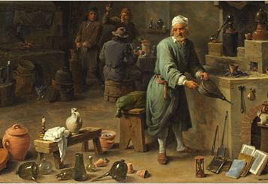
2
Science is situated in places
It is shaped by the places it is produced and transmitted through
The apparent placeless nature of science is itself a product of certain spaces
Notes:
A common way to imagine the history of modern science is that it arose in renaissance Italy and developed mostly in the Western world
At the same time, science is supposed to be something very different from for instance technology, practical labor and so on
This however, is a story shaped by scientists who wanted to make science into something special, and promote themselves as the scientific pioneers
(the Royal Society was for instance eager in presenting themselves as the true pioneers of science, what others were doing, was not really science)

Slide 11
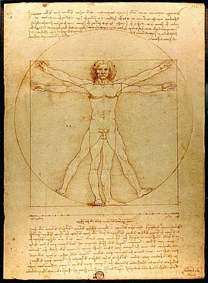
3
Science is not one, indivisible and united
The sciences are many, disunified and diverse
Notes:
Many sciences about the human and her behavior
Biological, psychological and cultural/societal explanatory models
We find this for instance in the science wars etc.
Both, but hardly a unity among the sciences

Slide 12
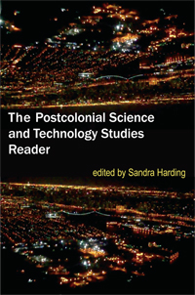
4
No single, coherent and effective scientific method
Neither does scientists have particular cognitive abilities that cannot be found in other technical practices or everyday routines
Notes:
Big debate
Who’s knowledges, what kind of knowledge, how to produce knowledge
But also a debate where you see many different definitions of scientific method in play

Slide 13
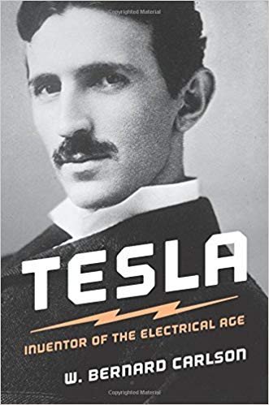
5
Scientists are morally heterogenous and ordinary
Ordinary people who produce unusually trustworthy knowledge
Notes:
Many myths about the scientific personae
Distracted, disembodied, gender etc.
Different times have produced different images of the scientific personae and his/her community
It varies what kind of traits are seen as vital for the scientist

Slide 14
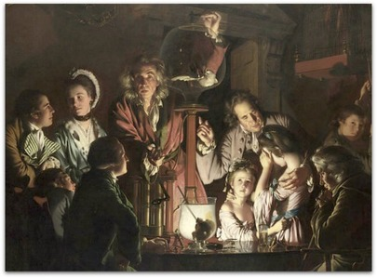
6
Truth is not a product of science, or something exclusive for the sciences (ex. Religious truths, juridical truths etc)
The history of science is not about truth, but about credibility (Latour: the sciences produce objectivity)
The history of science deals with what counts as true in different historical settings
Notes:
The experimentalists in the Royal Society developed a technique for witnessing experiments
Scientists should be modest witnesses whose research was not affected by their political and religious beliefs
But only people from certain classes, of certain genders and races could be modest witnesses
Can we see different ideals?

Slide 15
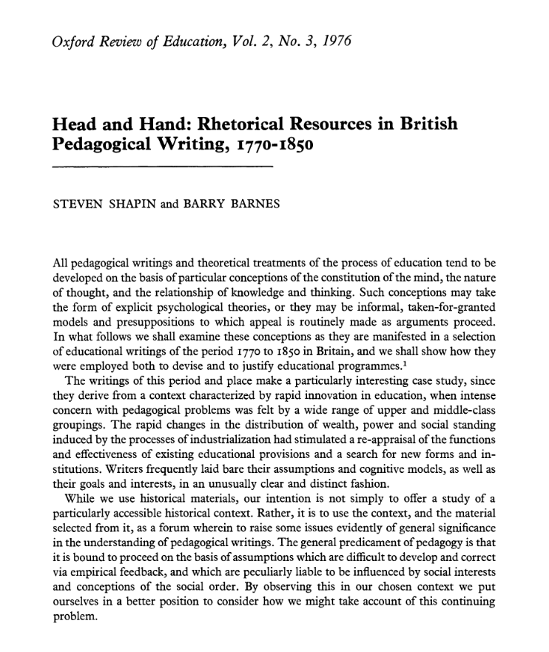
7
Science is not pure thought, but also practice
The hand is as important as the mind
Tinkering
Notes:
Non-explicated knowledges
Often linked to everyday life, but also important in scientific practice
Methodological skills, epistemological assumptions, textual aspects, writing
Does this make interdisciplinary work more difficult?

Slide 16
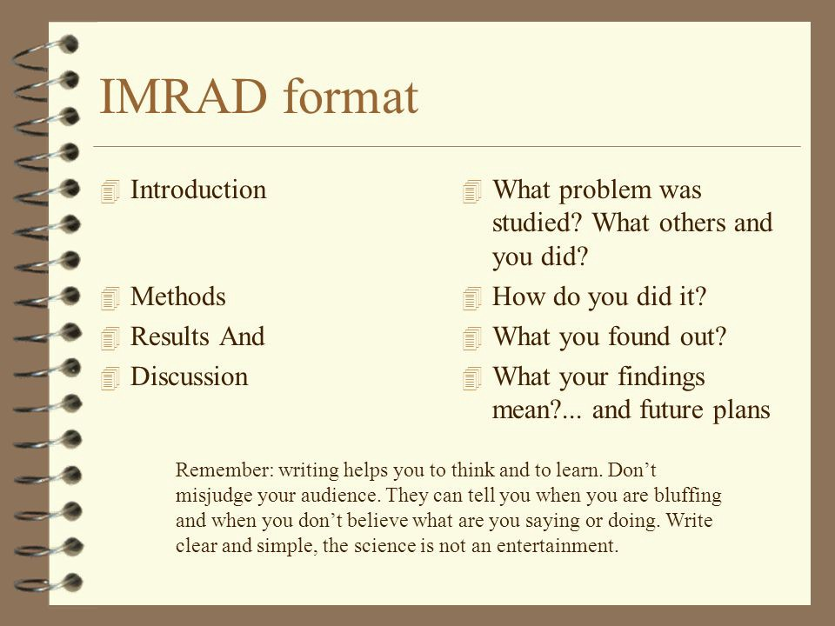
8
The production and legitimizing of scientific knowledge are performances
Science uses cultural resources to produce these performances
This includes displaying marks of integrity and entitlement (expertise, but also dedication and selflessness)
The idea of disembodied knowledge is a bodily performance
Notes:
What genres?
What language?
What styles?
Which references?
What journals?
Etc.

Slide 17
So what?
Shapin is mostly interested in (experimental) science
But the principles can also be used to question and situate other kinds of knowledge practices, disciplines and traditions
Even though all fields of knowledge and practice are historically situated, they are also cultures, with their own institutions, criteria for validity and credibility, tools and histories
Shapin’s principles useful for placing one's own discipline into historical context and for epistemological reflection upon one's own knowledge production
Epistemology important for “bildung” and academic citizenship, but also practically if we want to contribute with something new (which is part of what we are paid to do)
It could have been otherwise

Slide 18
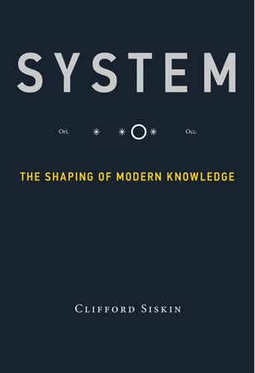
Science as systems of representation
When a group of researchers agree upon a statement, the job has barely started:
It must be stabilized in a wider group to become a fact
Scientific knowledge must be represented (models, figures, pictures, texts etc.) so it can travel and become fact
Representations are not natural, researchers make them. The interpretation of representations are not natural, researchers do them
How are representations made, interpreted, negotiated, stabilized?

Slide 19
Science as communication
If knowledge must be represented in order to be spread beyond the narrow confines of a particular laboratory/office (through journals, conferences etc), then communication become very important for scientists. Fact/knowledge is established through scientific communication
Thus, we can ask:
  Is communication one of the preconditions of modern science?
  How has knowledge been communicated in your discipline at different times, by and to whom, for what etc?

Slide 20
The scientific life
Some versions

Slide 21
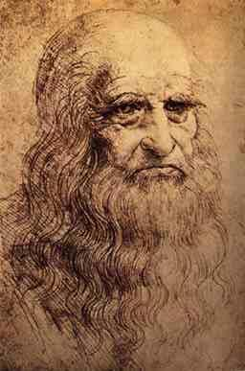
The scientific person in the late middle ages
Renaissance around 1400 in Italia
Dependent on private or church sponsorships
One and the same person should meddle in many subjects: architecture, engineering, mathematics, painting, theology etc. (see the jesuits in Clark)
Humanities as the central topics
Geniuses as Michelangelo and Leonardo da Vinci
Institutions: The schools of the church, monasteries, universities (not necessarily production of new knowledge)
Pre-modern science: a personal and moral calling bestowed upon individuals, little support infrastructure.
Pre-modern, or simply the beginning of modernity? (See: Toulmin, Cosmopolis. The hidden agenda of modernity)

Slide 22
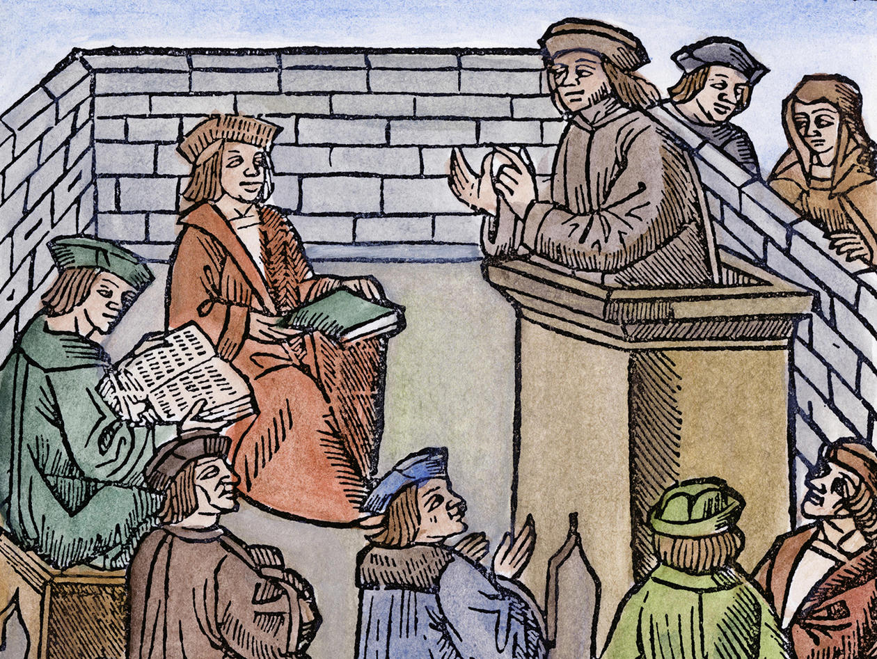
Ex. certification
Master of arts highest degree
PhD as an award
But, around 1450, the so-called humanists came to Germany from Italy
Saw the bachelor’s and master’s curriculum as «barbaric» as it lacked knowledge of classical literature and Latin
The transition ritual was a public and oral dissertation

Slide 23
The scientific person in early modernity
A long process between Copernicus’ de revolutionibus (1543) and Isac Newtons Principia (1687)
Change took a long time, and there was no clear line of development
Many processes:
Mechanization of nature (machines)
De-personalizing science (nature as mathematics)
Attempts at mechanizing knowledge (objective methods)
But, also unclear demarcation between chemistry and alchemy
Still calling, but also the rise of peer communities (Royal society)
The scientific person as independent from politics, interests, needs etc.
Shaped also experiments

Slide 24
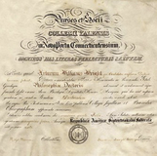
The PhD
The PhD as transition ritual
Became common in the 18th and 19th century
Germany: 1789
University of London: 1857
Yale: 1861
Cambridge: 1882

Slide 25
From renewal to creative and original
Berlin 1810: The Phd candidate not only have to pass a oral examination (in latin), but also produce a dissertation (in latin)
«The master’s degree is awarded to whoever can skillfilly renew and well order what has been learnt, and thus promises to be a useful link in the transmission of knowledge between generations. The doctor’s degree is awarded to whoever shows Eigenthümlichkeit (personality peculiarity, originality) and Erfindungsvermögen (creativity) in the treatment of academic knowledge»

Slide 26
But what did they actually write about?
PhD-thesis filled the gap between the papers of the seminars and the academic publication
Very common for PhD-theses to reconstruct the biography of some classic academic, not necessarily someone important
Also common to write about islands, forgotten towns, the history of a lost work, a fragment or something like that
A kind of serial production of new, but perhaps not terribly important things (the Preussian state worried)

Slide 27
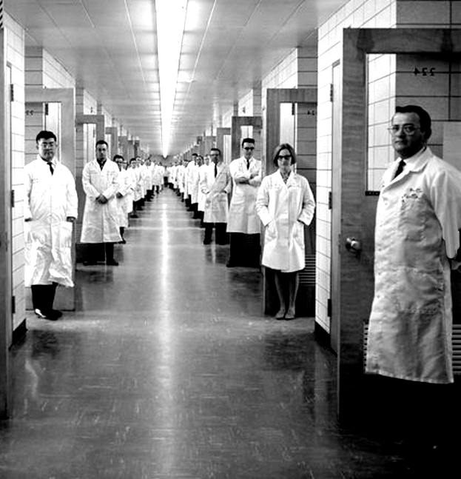
Modern science and its people
From calling to job
Science becomes a professionalized activity
Disciplines
Method and institutions rather than persons
The state takes control (research funding)
After a while: Big science
Meritocracy as the preferred criteria
From genius to group, but some exceptions (think the Kaiser Willhelm/Max Plank Institutes etc)

Slide 28
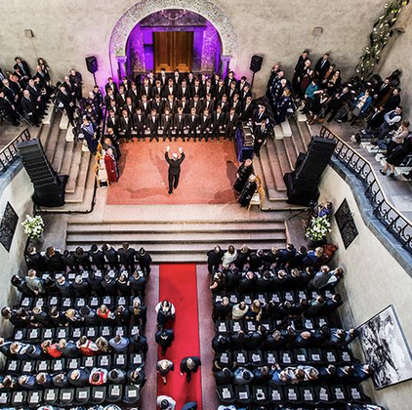
The PhD becomes the way in
The PhD as the result of a long career
But gradually: the PhD as the only way in
Very lonely work, but gradually as part of a system: education etc.
Scientific authority is to be found in the merits, method and the institutions (but, also a certain belief in “inheritance”).
A removal of the personal

Slide 29
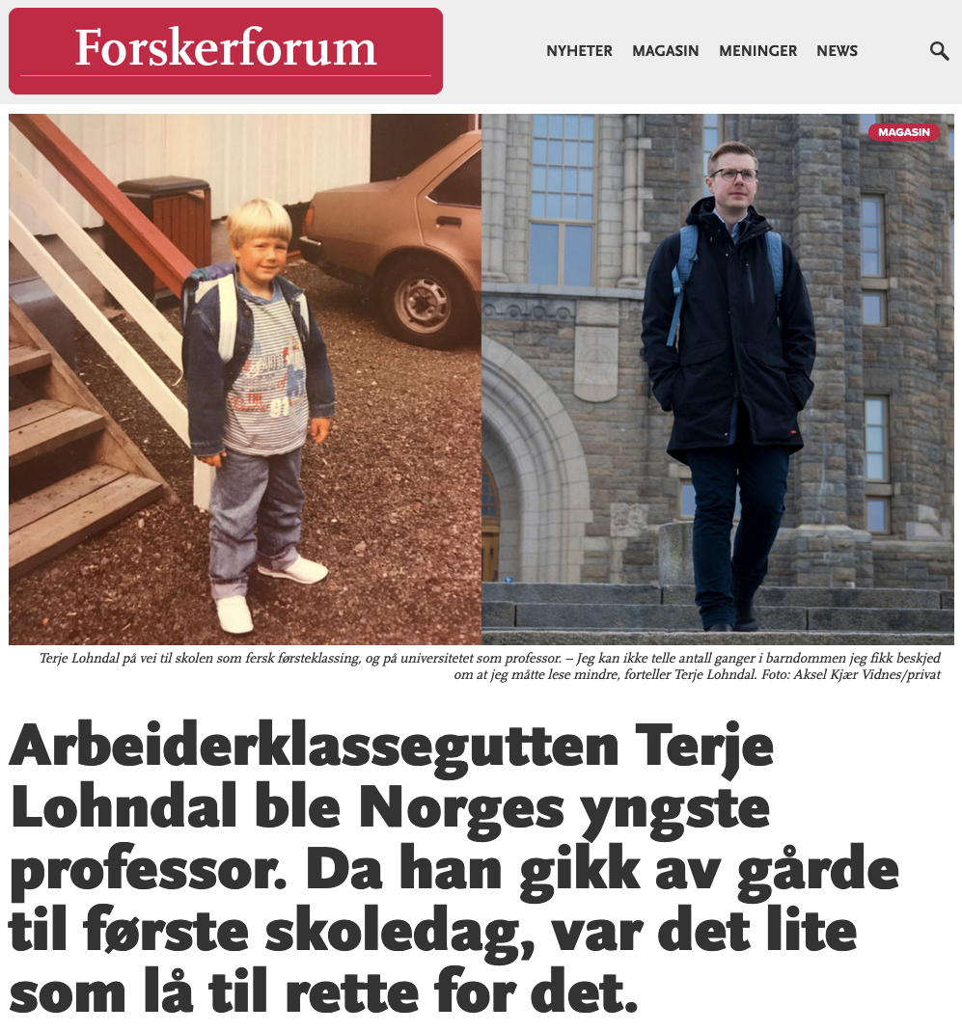
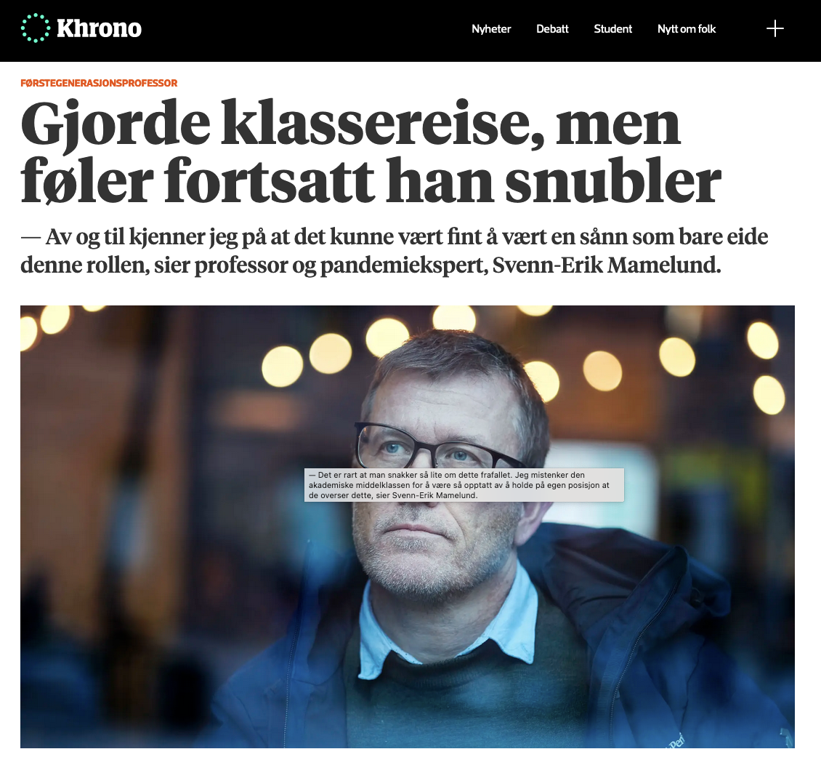
Academic life and background?
UiO 1961: 164 professors, 440 in other scientific positions (a lot of lektorer).
1957: Report «On acces to and the need for academic labor» by the Research councils: lacked everything from philologists to chemists, but not civil engineers, architects and veterinarians
People with artium (gave access to higher education): 4% in 1930 to ca. 11% in 1956.
«it is necessary that the students to a far greater degree than before are recruited from social groups that are not oriented towards higher education through their environment. The skewed recruitment to universities and colleges shows that it will take a long time before out «begåvningsreserv» (talent pool) is fully exploited. A significant increase of the number of students is fully possible without any reduction in the intellectual level amongst the students... For youth that are not environmentally disposed for higher education, it is not obvious that 6-8 years of studies with a modest living standard, debts and postponing marriage is something to long for» (Forskningsrådenes fellesutvalg, Om tilgangen på og behovet for akademisk arbeidskraft 1957)
«... the best farmers will be recruited from farming families or the best mechanics from families where this profession has been a tradition, I am also prone to assume that – under the same conditions – one will get the best recruits for academic work from families with academic traditions. And the sooner we get away from the idea that one is better than the other, the better.... At any time, there will be youth in the non-academic part of our population that has better pre-conditions to enjoy a academic work life than in the traditional line of work of their family... For these, the free choice must be open, or else we are back in the guild society before we know it and that is not a hopeful future» (Knut Fægri, Den akademiske rekrutteringen, Naturen 1957.)

Slide 30
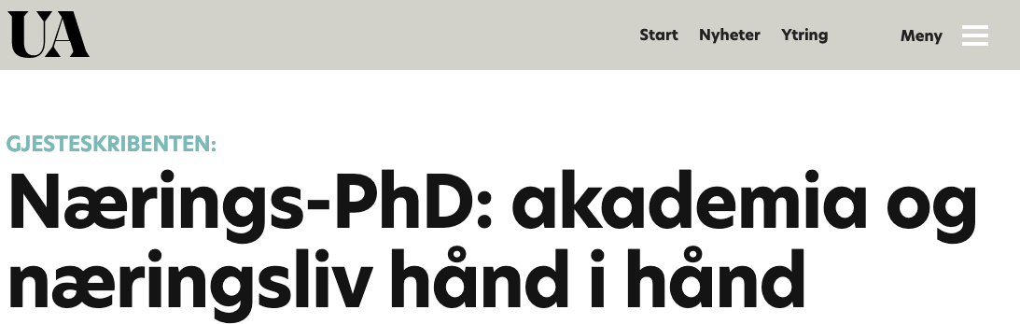
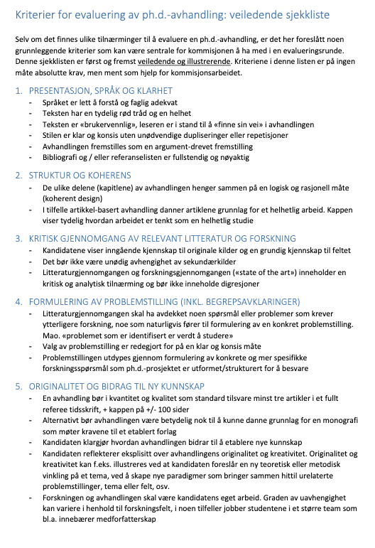
What about the present?
From job to lifestyle?
Scientific entrepreneurs
Project rather than institution?
Interdisciplinarity and hybrid subjects
From science to research to innovation?
Technoscience ridden with uncertainty.
Projects replaces disciplines and institutes?
A re-introduction of the personal: the charismatic entrepreneur?
PhDs written as part of projects, education etc. The potential beginning of a career, but not clear what career
still lonely, but less so?
And what about the weight of PhD-dissertations?

Slide 31
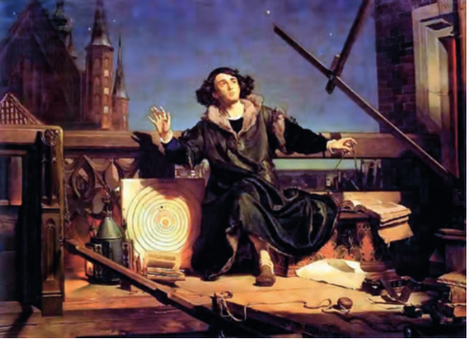
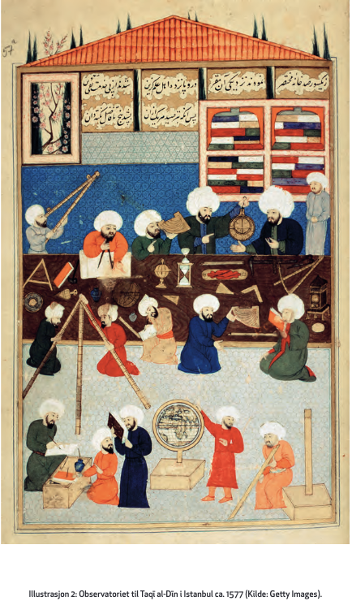
What about the rest of the world?
The history of science has been told as a history of progress, and has been fairly centered on the western world
But, other societies also had science
A turn towards the global history of science
But also towards questioning the ”boundaries of science” – science as one kind of knowledge that is not easily demarcated from others
(the catalogue of the exhibit ”Islamsk kunnskap i kontekst” at Teknisk museum in 2013: https://www.tekniskmuseum.no/dokumentlager/utstillingene/avsluttede-utstillinger/132-ilmkatalogmedforside-mindre/file )
More about postcolonial science and history later in the course

Slide 32
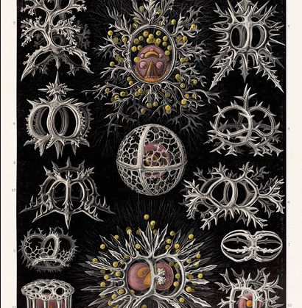
Changing values in the scientific life
Perhaps a point: Scientific values and valuations are very time and place bound even if they seem to have a long history
The value of objectivity
18th century: images (drawings, engravings) as interpretations that create order in the diversity of the natural world by representing the ideal, characteristic, naturalistic
19th century: images (mechanical reproduction) as non-subjective, not interpreted, “reproductions” of individual phenomena
20th century: models and simulations (computer) of potential outcomes, interpreted, productions of futures?
The values of the scientific life is worth reflecting on and sometimes to challenge, but perhaps equally important to know that there are many values at play here.

Slide 33
Discuss
What kind of scientific person is valued in your field?
What kind of scientific person do you want to be?
Why is a PhD important to you?
In what way does your PhD-life differ?

